Slide 1
KineticJS
Doing the Canvas the "easy way"!
Telerik Software Academy
Learning & Development
http://academy.telerik.com

Slide 2
Table of Contents
KineticJS overview and setup
Working with KineticJS
Initializing canvas
Drawing shapes
Rects, circles, paths, blobs
Event handlers
Attaching click, drag&drop

Slide 3
KineticJS
Overview and Setup

Slide 4
KineticJS Overview
KineticJS is a JavaScript framework to work with the Canvas
Introduces a refined API for canvas functionality
Has stages and layers for better canvas performance

Slide 5
KineticJS Setup
To use KineticJS:
Download the kinetic.js framework from the site
At http://kineticjs.com/
Include the framework into your HTML page:
<script src="scripts/…/kinetic-vX.X.X.js"></script>
Create a div with ID, where you want the canvas to be initialized:
<div id="canvas-container"></div>

Slide 6
KineticJS Setup (2)
To use KineticJS (cont.):
Do the following in the script
var stage = new Kinetic.Stage({
container: 'canvas-container',
width: 450,
height: 350
});
var layer = new Kinetic.Layer();
var rect = new Kinetic.Rect(options);
var circle = new Kinetic.Circle(options);
layer.add (rect);
layer.add (circle);
stage.add(layer);

Slide 7
KineticJS Setup (2)
To use KineticJS (cont.):
Do the following in the script
var stage = new Kinetic.Stage({
container: 'canvas-container',
width: 450,
height: 350
});
var layer = new Kinetic.Layer();
var rect = new Kinetic.Rect(options);
var circle = new Kinetic.Circle(options);
layer.add (rect);
layer.add (circle);
stage.add(layer);
Create a stage using the div id

Slide 8
KineticJS Setup (2)
To use KineticJS (cont.):
Do the following in the script
var stage = new Kinetic.Stage({
container: 'canvas-container',
width: 450,
height: 350
});
var layer = new Kinetic.Layer();
var rect = new Kinetic.Rect(options);
var circle = new Kinetic.Circle(options);
layer.add (rect);
layer.add (circle);
stage.add(layer);
Create a stage using the div id
Create a layer to add shapes

Slide 9
KineticJS Setup (2)
To use KineticJS (cont.):
Do the following in the script
var stage = new Kinetic.Stage({
container: 'canvas-container',
width: 450,
height: 350
});
var layer = new Kinetic.Layer();
var rect = new Kinetic.Rect(options);
var circle = new Kinetic.Circle(options);
layer.add (rect);
layer.add (circle);
stage.add(layer);
Create a stage using the div id
Create a layer to add shapes
Create shapes
Create shapes

Slide 10
KineticJS Setup (2)
To use KineticJS (cont.):
Do the following in the script
var stage = new Kinetic.Stage({
container: 'canvas-container',
width: 450,
height: 350
});
var layer = new Kinetic.Layer();
var rect = new Kinetic.Rect(options);
var circle = new Kinetic.Circle(options);
layer.add (rect);
layer.add (circle);
stage.add(layer);
Create a stage using the div id
Create a layer to add shapes
Create shapes
Create shapes
Add the shapes to the layer
Add the shapes to the layer

Slide 11
KineticJS Setup (2)
To use KineticJS (cont.):
Do the following in the script
var stage = new Kinetic.Stage({
container: 'canvas-container',
width: 450,
height: 350
});
var layer = new Kinetic.Layer();
var rect = new Kinetic.Rect(options);
var circle = new Kinetic.Circle(options);
layer.add (rect);
layer.add (circle);
stage.add(layer);
Create a stage using the div id
Create a layer to add shapes
Create shapes
Create shapes
Add the shapes to the layer
Add the shapes to the layer
Add the layer to the stage

Slide 12
Setting up KineticJS
Live Demo

Slide 13
Drawing Shapes with KineticJS

Slide 14
Drawing Shapes with KineticJS
KineticJS has all the default shapes from Canvas, and some more:
Rectangular
Circle
rect = new Kinetic.Rect({
fill: 'yellowgreen',
stroke: '#CCCCCC',
x: 250,
y: 350,
width: 57,
height: 93
});
circle = new Kinetic.Circle({
radius: 45,
fill: 'purple',
stroke: 'blue',
strokeWidth: 3,
x: 450,
y: 350,
});

Slide 15

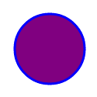
Drawing Shapes with KineticJS: Rect and Circle
KineticJS has all the default shapes from Canvas, and some more:
Rectangular
Circle
rect = new Kinetic.Rect({
fill: 'yellowgreen',
stroke: '#CCCCCC',
x: 250,
y: 350,
width: 57,
height: 93
});
circle = new Kinetic.Circle({
radius: 45,
fill: 'purple',
stroke: 'blue',
strokeWidth: 3,
x: 450,
y: 350,
});

Slide 16
Drawing Shapes with KineticJS: Straight and Curved Line
KineticJS has all the default shapes from Canvas, and some more:
Straight line
Curved line
straight = new Kinetic.Line({
points: [x1, y1, x2, y2],
stroke: 'green',
strokeWidth: 2,
lineJoin: 'round'
});
curved = new Kinetic.Line({
points: [x1, y1, x2, y2],
stroke: 'green',
strokeWidth: 2,
tension: 1
});

Slide 17
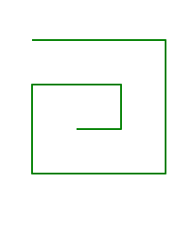

Drawing Shapes with KineticJS: Straight and Curved Line
KineticJS has all the default shapes from Canvas, and some more:
Straight line
Curved line
straight = new Kinetic.Line({
points: [x1, y1, x2, y2],
stroke: 'green',
strokeWidth: 2,
lineJoin: 'round'
});
curved = new Kinetic.Line({
points: [x1, y1, x2, y2],
stroke: 'green',
strokeWidth: 2,
tension: 1
});

Slide 18
Drawing Shapes with KineticJS: Polygon and Blob
KineticJS has all the default shapes from Canvas, and some more:
Polygon
Blob
polygon = new Kinetic.Line({
points: [ … ]
stroke: 'green',
fill: 'yellowgreen'
strokeWidth: 2,
closed: true
});
blob = new Kinetic.Line({
points: [ … ],
stroke: 'green',
fill: 'purple',
closed: true,
tension: 0.5
});

Slide 19
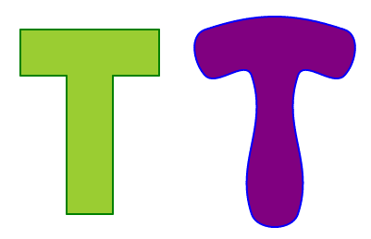
Drawing Shapes with KineticJS: Polygon and Blob
KineticJS has all the default shapes from Canvas, and some more:
Polygon
Blob
polygon = new Kinetic.Line({
points: [ … ]
stroke: 'green',
fill: 'yellowgreen'
strokeWidth: 2,
closed: true
});
blob = new Kinetic.Line({
points: [ … ],
stroke: 'green',
fill: 'purple',
closed: true,
tension: 0.5
});

Slide 20
Drawing Shapes
Live Demo

Slide 21
KineticJS Overview
http://academy.telerik.com

Slide 22
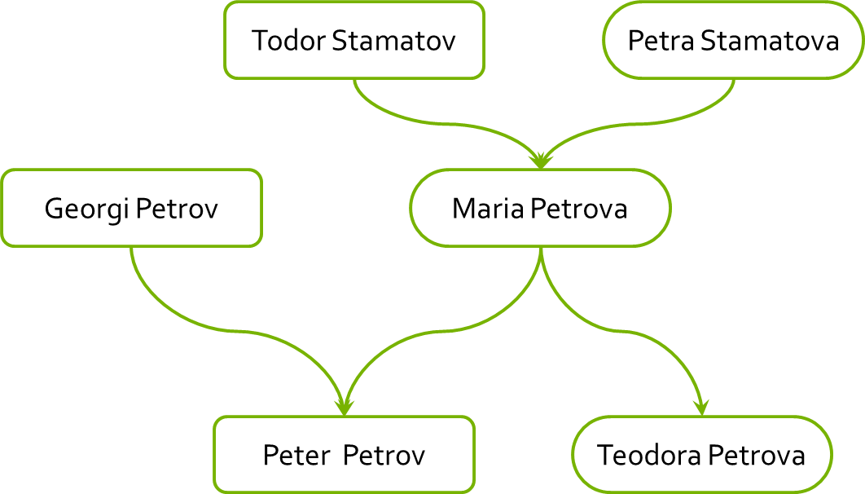
Homework
Read the tutorial on KineticJS:
At http://www.html5canvastutorials.com/kineticjs/html5-canvas-events-tutorials-introduction-with-kineticjs/
Read about custom shapes and text
Using Kinetic create a family tree
var familyMembers = [{
mother: 'Maria Petrova',
father: 'Georgi Petrov',
children: ['Teodora Petrova', 'Peter Petrov']
}, {
mother: 'Petra Stamatova',
father: Todor Stamatov',
children: ['Maria Petrova']
}]

